Slide 1


Slide 2


Slide 3
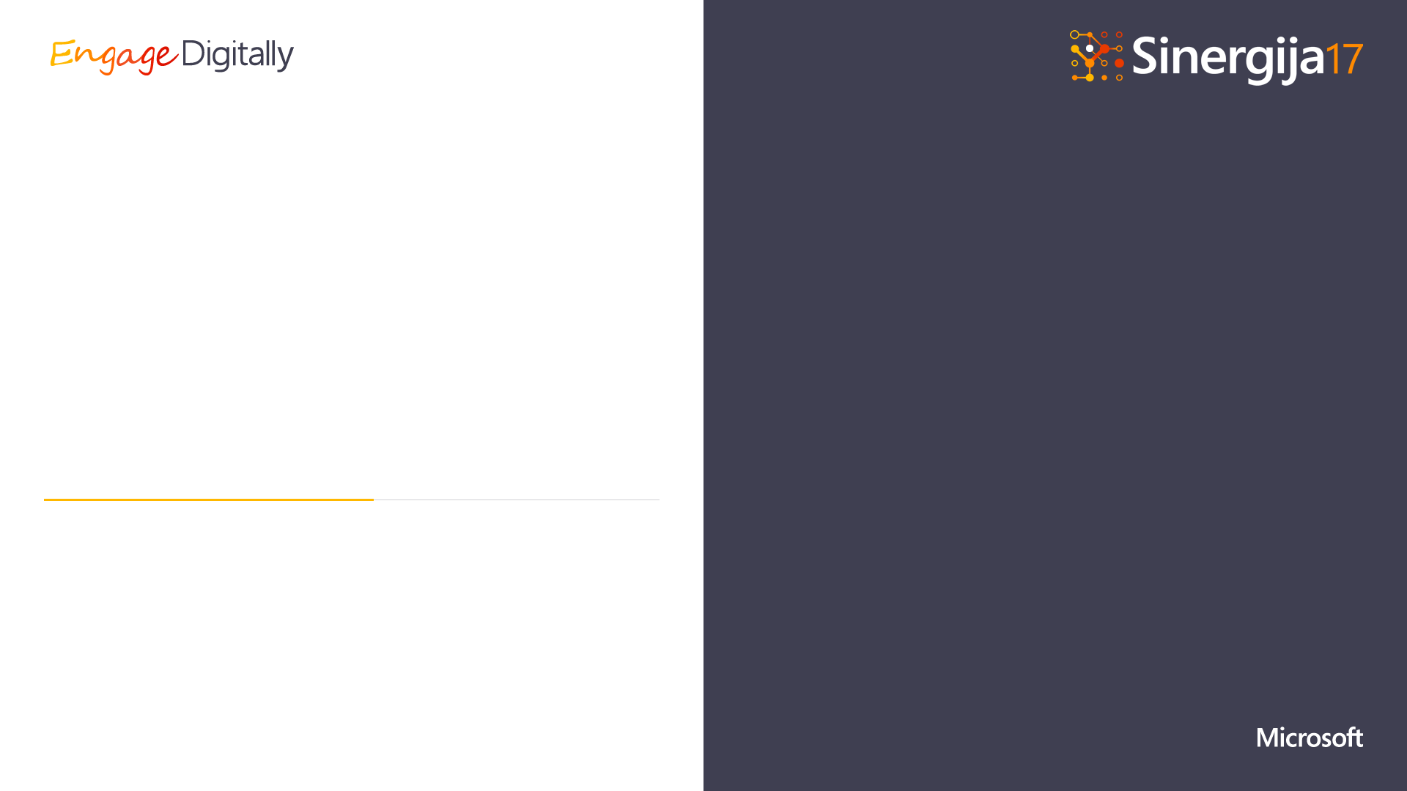
OpenMVVM
Stanko Nikolić
Bojan Mišić

Slide 4

OpenMVVM.org
github.com/BananaBytes/openmvvm
apps@openmvvm.org

Slide 5
What is OpenMVVM?

Slide 6



Pushing MVVM pattern to its limits
Consistent API through all platforms
The same app logic, framework fills the differences
HTML + C# - Reinvented

Slide 7
OpenMVVM
Contracts for Platorm Services
Base Page ViewModels
Platform Services Implementation
Your code
Business logic and services
ViewModels (app logic)
App

Slide 8



OpenMVVM
OpenMVVM.Core
OpenMVVM
.Windows
OpenMVVM
.Andriod
OpenMVVM
.Ios
OpenMVVM
.XamarinForms
OpenMVVM
.WebView
Contracts for Platorm Services
Windows Platform Services
Xamarin.Android Platform Services
Xamarin.iOS Platform Services
Xamarin Forms Platform Services
HTML Platform Services
Page ViewModels
Windows
Windows
Android
Android
iOS
iOS
App logic
Cross-platform
Business logic and services
ViewModels (app logic)
Windows App
XAML
Android App
AXML
iOS App
XamarinForms App
XAML
Open MVVM App
HTML

Slide 9
OpenMVVM.HTML
HTML/CSS/JavaScript UI
Easy binding syntax
But powerful!
C# application logic
Cross platform
100% code reuse
Extensible

Slide 10
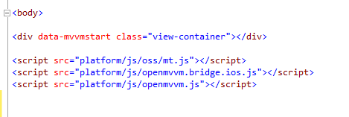


Slide 11



Slide 12
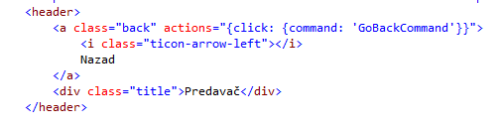

Slide 13
WebView
HTML, CSS, JS
HTML Binding Layer
openmvvm.js
JS Bridge Layer
openmvvm.windows.js
C# Binding Layer
View Models
openmvvm.android.js
openmvvm.ios.js
Windows: UWP WebView Control
Android: Xamarin WebView Control
iOS: Xamarin WebView Control
C# Bridge Layer
Windows Bridge
Android Bridge
iOS Bridge

Slide 14
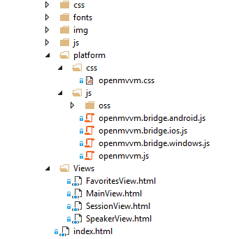

Slide 15
What’s new?

Slide 16
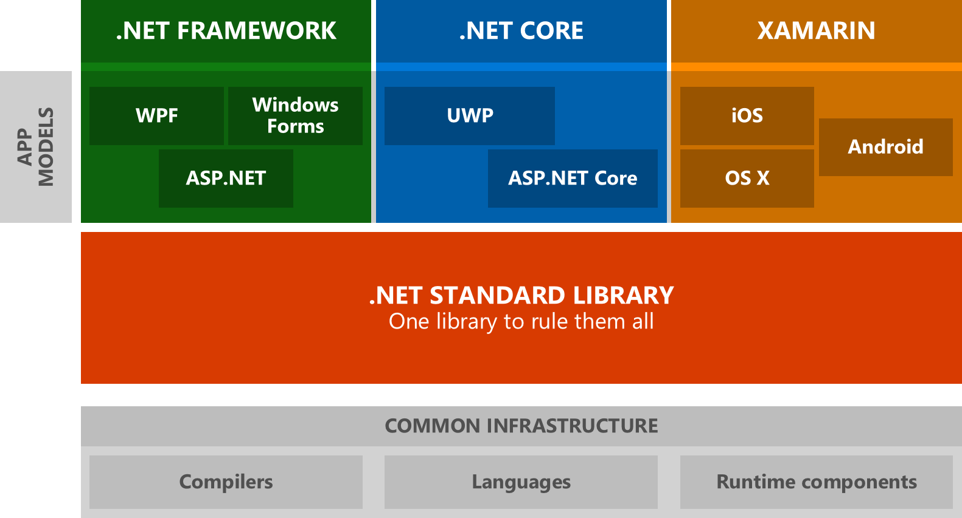

Slide 17


Slide 18
Operating System
Windows
Android
iOS
MacOS
Linux
Runtime
.NET
WinRT
Xamarin.Android
Xamarin.iOS
Xamarin.Mac
DotNetCore
Xamarin.UWP
UI Technology
WPF
UWP
XamarinForms
HTML

Slide 19
Demos

Slide 20
Operating System
Windows
Android
iOS
MacOS
Linux
Runtime
.NET
WinRT
Xamarin.Android
Xamarin.iOS
Xamarin.Mac
DotNetCore
Xamarin.UWP
UI Technology
WPF
UWP
XamarinForms
HTML

Slide 21
Operating System
Windows
Android
iOS
MacOS
Linux
Runtime
.NET
WinRT
Xamarin.Android
Xamarin.iOS
Xamarin.Mac
DotNetCore
Xamarin.UWP
UI Technology
WPF
UWP
XamarinForms
HTML

Slide 22
Operating System
Windows
Android
iOS
MacOS
Linux
Runtime
.NET
WinRT
Xamarin.Android
Xamarin.iOS
Xamarin.Mac
DotNetCore
Xamarin.UWP
UI Technology
WPF
UWP
XamarinForms
HTML

Slide 23
Operating System
Windows
Android
iOS
MacOS
Linux
Runtime
.NET
WinRT
Xamarin.Android
Xamarin.iOS
Xamarin.Mac
DotNetCore
Xamarin.UWP
UI Technology
WPF
UWP
XamarinForms
HTML

Slide 24
Operating System
Windows
Android
iOS
MacOS
Linux
Runtime
.NET
WinRT
Xamarin.Android
Xamarin.iOS
Xamarin.Mac
DotNetCore
Xamarin.UWP
UI Technology
WPF
UWP
XamarinForms
HTML

Slide 25
Remote App Concept

Slide 26

Azure Service Fabric
App1
App2
identity
Session1
Session1
HTML/json (SignalR)
Session2
Session2
Session3
HTML Session1

Slide 27
Demo

Slide 28
Project Budapest

Slide 29
Anything
ViewModel

Slide 30
Demo

Slide 31
OpenMVVM.org
github.com/BananaBytes/openmvvm
apps@openmvvm.org

Slide 32


